Slide 1
Real-Time Image Processing
Joshua Castillo Yeachan Okh
Vincent Seymour Ignacio Velasco

Slide 2
MOTIVATION -
IMAGE PROCESSING APPLICATIONS
Forensic investigations
Medical imaging
Industrial quality control
Computer vision for object detection
Art and design
Image compression

Slide 3
BENCHMARK
To figure out which coding language is better in terms of performance
C++ (OpenCV 4.10.0)
Python (3.13.0) (OpenCV 4.10.0)
To compare two different hardware kits running those codes
Raspberry Pi 5 (ARM Cortex A76 Quad Core Processor 8GB LPDDR4X RAM)
Raspberry Pi 4 Model B(Broadcom BCM2711 Quad core Cortex-A72 (ARM v8) 64-bit SoC 8GB DDR4 RAM)

Slide 4






SIX DISTINCT REAL-TIME FUNCTIONS
None
Grayscale
Negative
Remove Red
Remove Green
Remove Blue

Slide 5
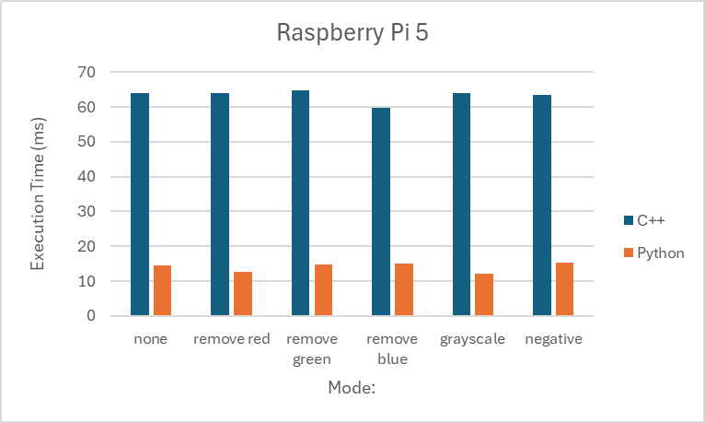
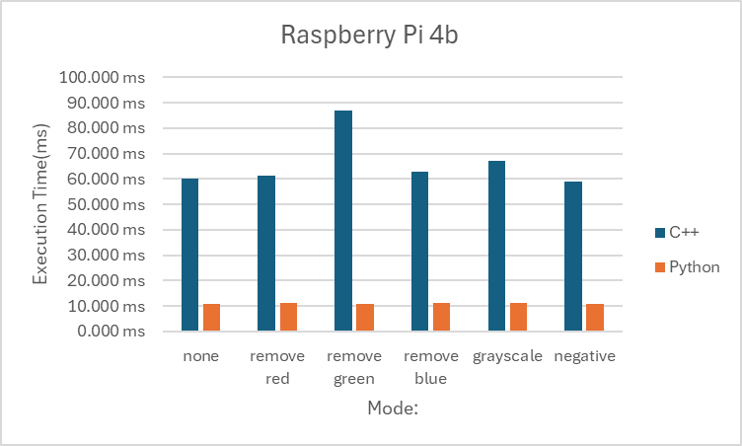
RESULTS COMPARISON ( Execution Time)
Raspberry Pi 5
Consistently achieved faster execution times in C++ but slower in Python 3.13.0
Raspberry Pi 4b
Slower execution times in both cases, especially when runs first

Slide 6
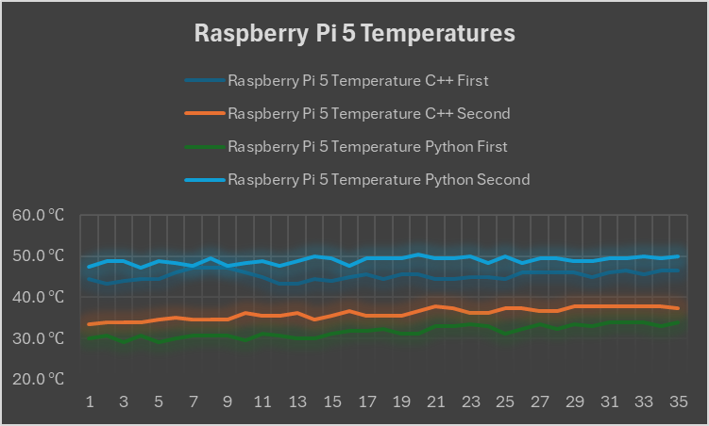
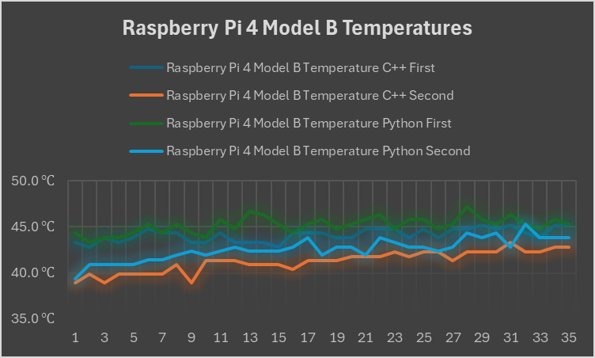
RESULTS COMPARISON ( CPU Temp)
Raspberry Pi 5
Python always heated more than C++ while C++ ran hotter in the 4b
Raspberry Pi 4b
Better thermal efficiency for both C++ and Python

Slide 7
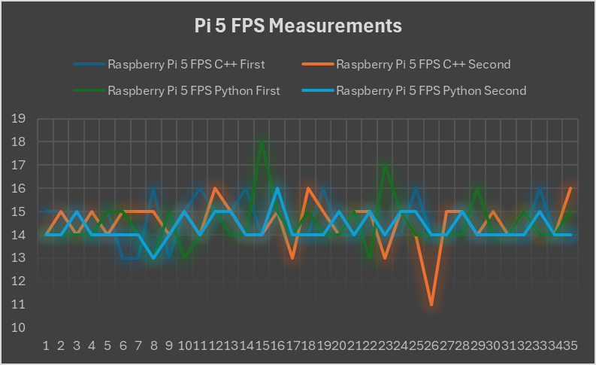
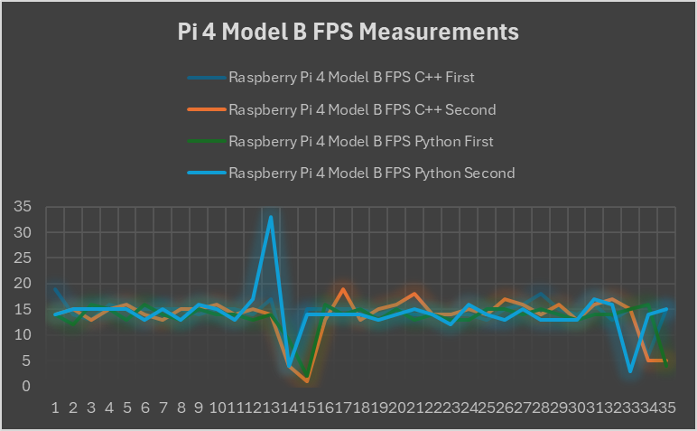
RESULTS COMPARISON ( FPS)

Slide 8
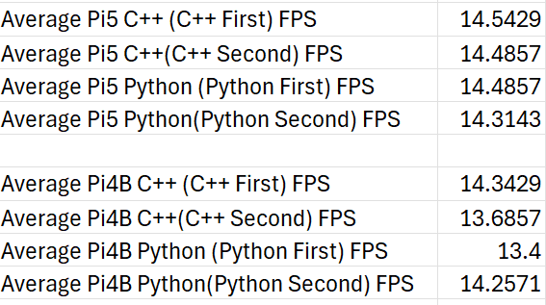
VERSUS THE COMPETITION Pt.1
Competitor #1
The results from stereopi.com show that C++ has an average FPS of 40 at 1240x480 and Python has 15 FPS. For 640x240 it is 90 FPS for C++ and 20 FPS for Python. For our demo our Resolution is 640x480
Our Project
For our demo it runs at a resolution of 640x480 across all demos, C++ and Python. The Pi5 has the most consistent FPS at an mean of 14.4572. C++ has a mean of 14.2643 Across both Pi’s
Results
Nemo enim ipsam voluptatem, quia voluptas sit, aspernatur aut odit aut fugit, sed quia consequuntur magni dolores eos.

Slide 9
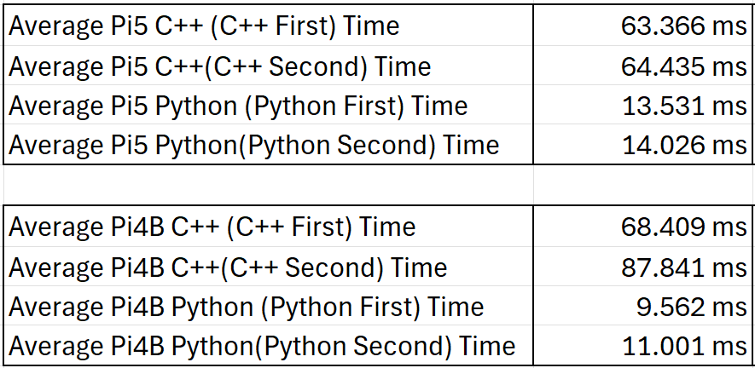
VERSUS THE COMPETITION Pt.2
Competitor #2
The results from programming-language-benchmarks.vercel.app compares python vs C++ for a variety of codes. On average C++ is faster than Python.
Our Project
The results from the project show that Python is much faster than C++. This seems to be due to the way VScode worked with Open-CV for C++ vs Python
Results

Slide 10
FUTURE WORKS
Some Future Works for this could include adding more functions to the Image Processor
Apply A Blur Function (Gaussian Blur)
Sharpen Function
Brightness Function
Contrast Function
Sepia Tone

